Slide 1
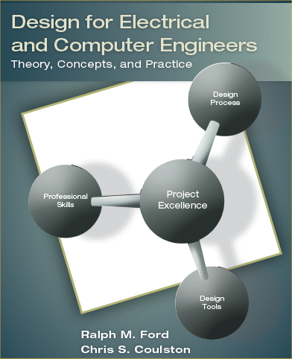
Chapter 1 – The Engineering Design Process

Slide 2
Motivation – Let’s fill in the blanks [Source: Ullrich & Eppinger]
 | Stanley Screwdriver | HP DeskJet Printer | VW Beetle
Annual Production Volume
Sales lifetime
# parts
Development time
Development team
Development cost
Production investment

Slide 3
And the answers are …
 | Stanley Screwdriver | HP DeskJet Printer | VW Beetle
Annual Production Volume | 100,00 | 4 million | 100,000
Sales lifetime | 40 years | 2 years | 6 years
# parts | 3 | 200 | 10,000
Development time | 1 year | 1.5 years | 3.5 years
Development team | 6 | 175 | 1,600
Development cost | $150K | $50 million | $400 million
Production investment | $150K | $25 million | $500 million

Slide 4
Chapter 1 – Learning Objectives
By the end of this chapter, you should:
Understand what is meant by engineering design.
Understand the phases of the engineering design process.
Be familiar with the attributes of successful engineers.
Understand the objectives of this book.

Slide 5
ABET Definition of Engineering Design
Engineering design is the process of devising a system, component, or process to meet desired needs. It is a decision-making process (often iterative), in which the basic sciences, mathematics, and engineering sciences are applied to convert resources optimally to meet a stated objective. Among the fundamental elements of the design process are the establishment of objectives and criteria, synthesis, analysis, construction, testing, and evaluation. [ABET]

Slide 6
1.1 Engineering Design Processes
What is a design process?

Slide 7
General types of design processes
Prescriptive
Descriptive

Slide 8
A Prescriptive Process

Slide 9
A Descriptive Process

Slide 10
VLSI Design Process
Is this prescriptive or descriptive?

Slide 11
Embedded Systems Design Process
Prescriptive or descriptive?

Slide 12
Waterfall Software Development
Prescriptive or descriptive?

Slide 13
Design Processes – WHO CARES?
What is the value of the design process?
How much does it cost to correct problems as process proceeds?

Slide 14
Cost to Implement Changes

Slide 15
Design Process – this book
Problem ID & customer needs (Ch 2)
Research/Problem Analysis (Ch 2)
Requirements Specification (Ch 3)
Concept Generation & Evaluation (Ch 4)
Design Phase (Ch 5, 6, & 8)
Prototype, Construct, & Test (Ch 7)

Slide 16
Other material in the Chapter
Penn State World-Class Engineer Description.
Overview of the book.

Slide 17
1.4 Summary
Engineering design is an iterative process.
Design problems are open-ended with many potential solutions.
Design processes represent best practices for realizing a system.
Design processes may be prescriptive or descriptive.

